Slide 2
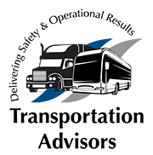
Mastering DOT Compliance: Preparing for Audits + Hours of Service
JOE GUINN
LBC Fleet + Compliance
TOM HOLDEN
Transportation Advisors
Audio Visual
Sponsor
Coffee Sponsor

Slide 3
Welcome & Thank You to Our Sponsors

Slide 4
AGENDA
How an Audit Begins
DQ Files
Drug + Alcohol Testing
Hours of Service (HOS)
Interstate Authority + Interpretations by FMCSA
Audio Visual
Sponsor

Slide 5
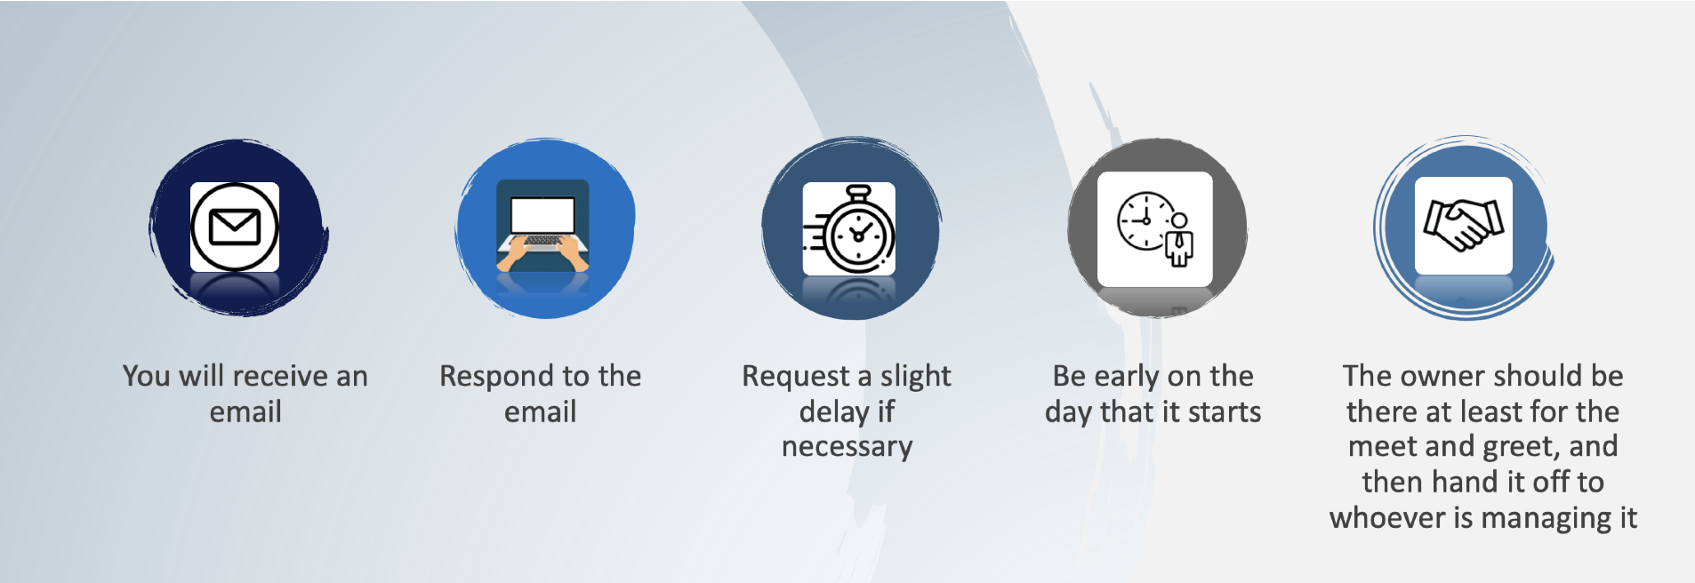
HOW AN AUDIT BEGINS
Audio Visual
Sponsor

Slide 6
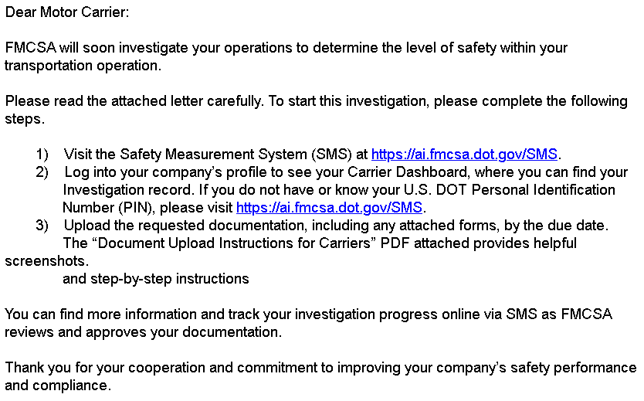
SAMPLE EMAIL
Audio Visual
Sponsor

Slide 7
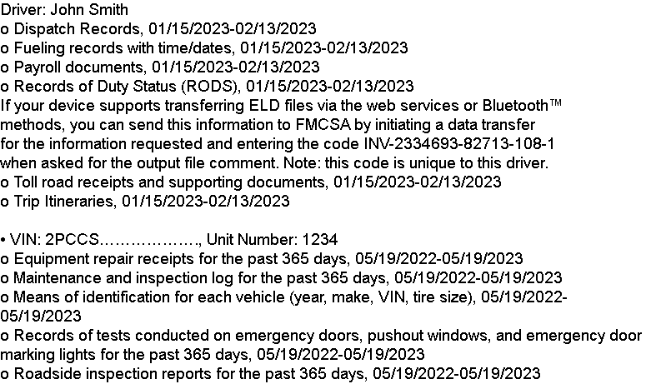
DOCUMENTATION
Driver List: CDL/Non-CDL
Accident Register: Reportable accidents 1.5x 1 million miles
Equipment List
Investigation Questionnaire
Audio Visual
Sponsor

Slide 8
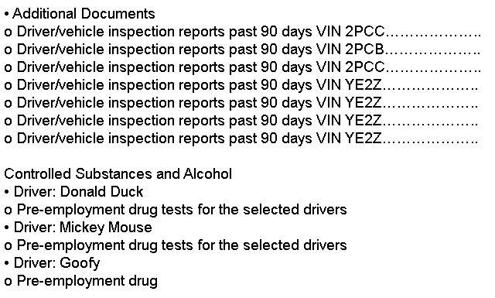
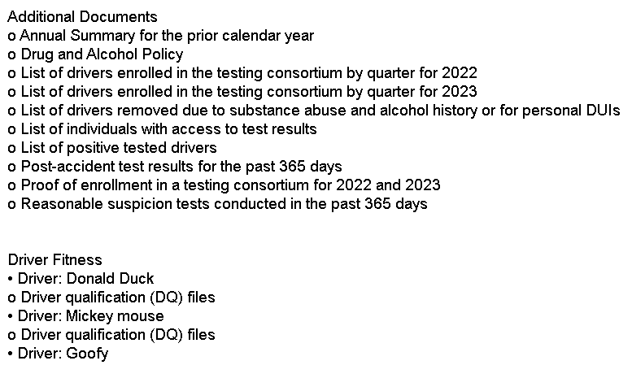
DOCUMENTATION
Audio Visual
Sponsor

Slide 9
OTHER REQUESTS
Policies + Procedures: Drug and Alcohol Policy that includes updated information about the Clearinghouse.
Driver Safety Meetings: Attendance sheets, email minutes of the meetings to drivers who were not present.
What type of disciplinary action was taken, where was that information stored?
Audio Visual
Sponsor

Slide 10
DQ FILES
Who Needs a DQ File?
Driver-Specific Required Items
Expiring Items
Common Issues
Paperwork Retention
Audio Visual
Sponsor

Slide 11
DQ FILES: WHO NEEDS A DQ FILE?
Applicable Regulation: FMCSRs – 49 CFR Part 391 – Qualification of Drivers
Non-CDL CMV Drivers
Anyone who operates a vehicle exceeding 8 passengers in interstate commerce – ex: van or limo runs to the airport.
CDL Drivers
Drivers operating vehicles that seat 16+ passengers.
Audio Visual
Sponsor

Slide 12
DQ FILES: DRIVER SPECIFIC APPLICATION 391.21
Required Items
Name and address of the motor carrier
Applicant’s name, address, DOB, and SSN
3 years of address history
License state, number, and expiration
Experience type by vehicle
Accident and violation history for 3 years
Explanation of any denial, revocation, or suspension
List of all jobs worked in the last 3 years, 10 years for driving jobs: Must explain gaps, reason for leaving, whether DOT regulated, whether subject to DOT drug testing, and dates employed
Certification of Accuracy
Audio Visual
Sponsor

Slide 13
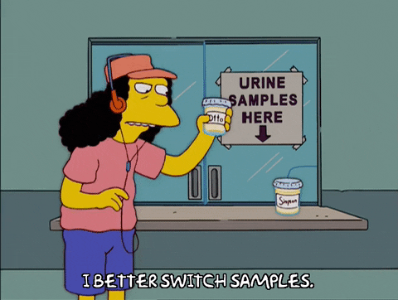
DQ FILES: DRUG TESTING (CDL ONLY)
Required Items
Receipt of Substance Abuse Policy
Negative Pre-employment Drug Test: Must list FMCSA and pre-employment
Self-certification that applicant didn’t have a failure or refusal in the previous two years
Drug & Alcohol Clearinghouse full query
Add to random drug testing
Audio Visual
Sponsor

Slide 14
DQ FILES: DOT MEDICAL CARD
Must be performed by a doctor listed on the National Registry of Medical Examiners.
Must be signed and include the national registry number.
If interstate operator, the top box for interstate work must be selected.
Company must verify the registration and save a copy to the file.
Non-CDLs: Must carry their copy when operating CMVs.
For CDLs: Must be submitted to the state and verified on the MVR: most operators should be Non-Excepted Interstate.
Audio Visual
Sponsor

Slide 15
DQ FILES: RELEASES + ACKNOWLEDGEMENTS
FMCSRs
Notification of Rights
(i) The right to review information provided by previous employers;
(ii) The right to have errors in the information corrected by the previous employer and for that previous employer to re-send the corrected information to the prospective employer;
(iii) The right to have a rebuttal statement attached to the alleged erroneous information, if the previous employer and the driver cannot agree on the accuracy of the information.
MVR Release
Reason for Pre-employment Test and Release of Information (CDL)
Clearinghouse Release (CDL)
Audio Visual
Sponsor

Slide 16
DQ FILES: SAFETY PERFORMANCE HISTORY
Must complete a good faith effort within 30 days
Must have a signed release
Must Contain:
Current MVR for each state lived in during previous 3 years
Previous employer’s name, address, date contacted
If no previous DOT employers, document and save to file
Information Covered:
General identification and employment info
Dates of accidents
Any information regarding drug and alcohol violations
Information regarding SAP programs
Audio Visual
Sponsor

Slide 17
DRUG + ALCOHOL TESTING
Consortium or In-House?
Types of Tests
Pre-Employment
Random
Post-Accident
Reasonable Suspicion
Follow-Up
Return to Duty
Audio Visual
Sponsor

Slide 18
CONDUCTING DRUG + ALCOHOL TESTING
Common Errors
Testing time frame
Test type
Safety sensitive functions
Common Violations
Using a driver before receiving negative results
Not completing an appropriate amount of random testing
Audio Visual
Sponsor

Slide 19
REASONABLE SUSPICION TRAINING
ALL Supervisors of Drivers
Does Not Expire
Must Be Completed to Require a Reasonable Suspicion Test
Audio Visual
Sponsor

Slide 20
DRUG + ALCOHOL CLEARINGHOUSE
What Is DACH?
How to Register:
Create an account at portal.fmcsa.dot.gov – you’ll need company info including USDOT PIN;
Create an account at clearinghouse.fmcsa.dot.gov, register as an employer (if you drive CDL vehicles select owner operator);
add your C/TPA;
purchase queries (1.5x CDL driver count)
How to Conduct Queries:
Full Query = pre-employment or when results found, driver must consent;
Limited Query = conducted 1x/year, company must have consent form on file
Required Reporting
Positive Drug Results
Reported to MRO, not the company
Refusal to Test or Knowledge of Violation
Document and report
Driver Notification (Via Mail)
Copy of results
Copy of drug policy
List of SAPs
Audio Visual
Sponsor

Slide 21
DRUG + ALCOHOL TESTING: CONSORTIUMS OR IN-HOUSE
Consortiums
Companies can be placed in a larger pool of companies known as a consortium.
Consortiums place your drivers in a pool with other companies and mathematically give some advantages.
The consortium should provide a yearly analysis of the testing done, including names of those tested in your company, dates, results, etc.
Audio Visual
Sponsor

Slide 22
DRUG + ALCOHOL TESTING: TYPES OF TESTS
Pre-Employment Drug Testing
ALL CDL drivers MUST submit to and have a negative test BEFORE performing safety sensitive functions – this is non-negotiable.
Random Drug Testing
50% of all CDL drivers must be randomly tested annually.
10% of all CDL drivers must be randomly tested for alcohol annually.
Doing this quarterly is best practice but not required.
The candidates MUST be RANDOMLY chosen.
Please note: Other governing bodies or company policies may also require testing for non-CDL drivers, and these drivers must be in a separate pool.
Companies may use a third-party administrator to select and administer drug tests.
Post Accident: Must be a CDL driver and be involved in an accident in which:
They were driving a commercial motor vehicle (DOT Regulated) AND
There was a fatality OR
The driver was cited AND
Someone required immediate medical treatment away from the scene OR
A vehicle was damaged and required a tow
Reasonable Suspicion Testing
Driver’s behavior must be directly observed and documented by someone who has received the 2-hr Reasonable Suspicion Training.
Return to Duty + Follow Up
These are required tests only for CDL drivers who have failed a drug or alcohol test. They are administered at the discretion and approval of a Substance Abuse Provider (SAP),
Not following an SAP return to duty schedule will hurt your company.
Audio Visual
Sponsor

Slide 23
HOURS OF SERVICE (HOS)
HOS Regulations – Passenger-Carrying Drivers
10-Hour Driving Limit: May drive maximum of 10 hours after 8 consecutive hours off duty.
15-Hour Limit: May not drive after having been on duty for 15 hours, following 8 consecutive hours off duty. Off-duty time is not included in the 15-hour period.
60/70-Hour Limit: May not drive after 60/70 hours on duty in 7/8 consecutive days.
Sleeper Berth Provision: Drivers using a sleeper berth must take at least 8 hours in the sleeper berth, and may split the sleeper berth time into two periods provided that neither is less than 2 hours. All sleeper berth pairing MUST add up to at least 8 hours.
Audio Visual
Sponsor

Slide 24
HOURS OF SERVICE (HOS)
HOS Regulations – Passenger-Carrying Drivers (cont.)
Adverse Driving Conditions: Drivers are allowed to extend the 10-hour maximum driving time OR 15-hour on-duty limit by up to 2 hours when adverse driving conditions are encountered, AND only to the next point of safety.
Short-Haul Exemption: A driver is exempt from the requirements if the driver operates within 150 air-mile radius of the work reporting location. Drivers must report and return to normal work reporting location within 14 consecutive hours AND stay within the 150 air-mile radius.
Audio Visual
Sponsor

Slide 25
INTERSTATE AUTHORITY
What Is Interstate Operating Authority?
Often referred to as an "MC," "FF," or "MX" number
Grants permission to operate commercial vehicles in interstate commerce
Different from a USDOT number
Who Needs Interstate Operating Authority?
You are required to obtain Interstate Operating Authority if your business:
Operates as a for-hire carrier (transporting passengers or property for compensation)
Transports federally regulated commodities or arranges for their transport across state lines
Offers passenger transportation services in interstate commerce
Exceptions:
Private carriers transporting their own goods, For-hire carriers exclusively hauling exempt commodities like unregulated agricultural products
Carriers operating solely within federally designated “commercial zones” near state borders
Audio Visual
Sponsor

Slide 26
INTREPRETATIONS BY FMCSA
As of Feb 2025, the FMCSA has not issued any significant NEW interpretations of existing regulations.
Audio Visual
Sponsor

Slide 27
Thank you!
Q&A
Audio Visual
Sponsor

Slide 28
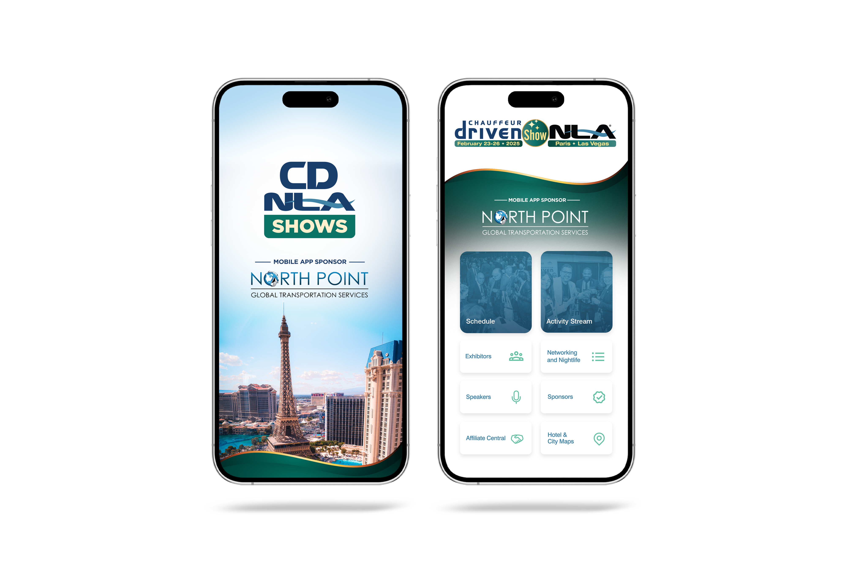
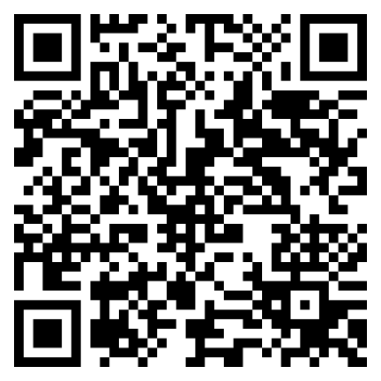
Let Us Know How
We Did!
Fill Out the Survey

Slide 29
Thank You for Joining Us!

